Slide 1
SS ZG653: Software Architecture Lecture 12: Interactive and Adaptable Systems
Instructor: Prof. Santonu Sarkar
March 3, 2015

Slide 2
Model View Controller Pattern
Interactive Systems

Slide 3
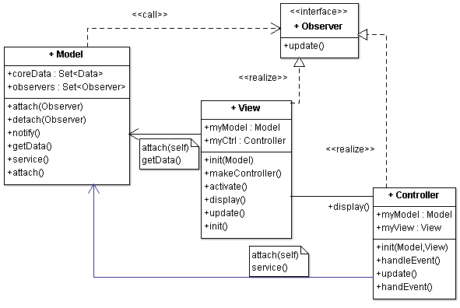
Model-View-Controller
User makes change in UI, which comes to controller
Controller interprets the change, informs model for the change
Model makes change in data
Model notifies all the relevant views regarding the change
View gets latest data and updates the display

Slide 4
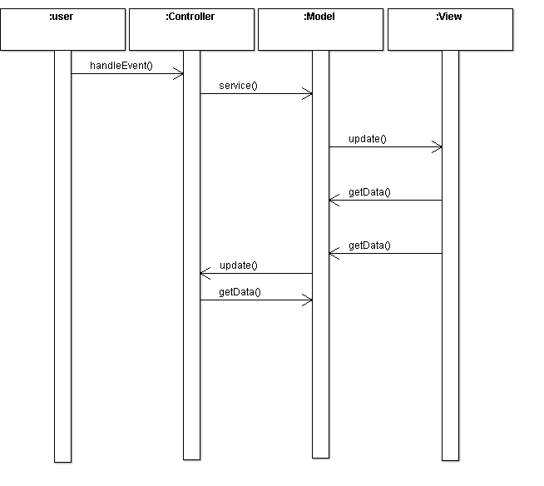
MVC Dynamics- User Event
notify()
display()

Slide 5
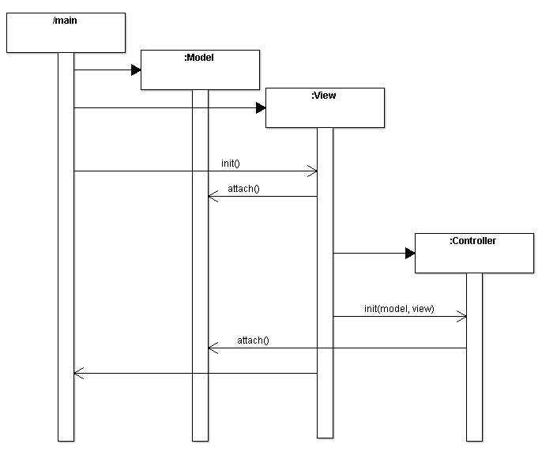
MVC Initialization
makeController()
startEventProcessing()

Slide 6
Other Dynamic Scenarios
Update to display alone i.e. no change in the controller
System exit. Sequence of deletion or destruction of objects
Scenario of update with multiple View-Controller pairs
…

Slide 7
Implementation
 | # | Steps
Fundamental steps for realising a MVC | 1 | Separate human-computer interaction from the core functionality
 | 2 | Implement the set-up of MVC setup part
 | 3 | Design and implement Model
 | 4 | Design and implement views
 | 5 | Design and implement controllers

Slide 8
Initial Part
2. Set-up MVC
1: Separate Human-Computer Interaction
Analyze and separate the core functionality of your system and data from input and output
Decide on the functionality to be exposed to View(s) and controller(s)
Decide how many views and controllers you need
Write code that calls Model initialization method
Write code to call view creation
Write the Start the event processing mechanism

Slide 9
3: Design the Model
Encapsulate the data and functionality to access and modify data
Bridge to the core business logic of the system
Publish-Subscribe design pattern
Implement a registry that holds references of observers (Views and Controllers)
Provide APIs for an observer to subscribe and unsubscribe
Implement notify() which will be called every time the (other) parts of the system change the model’s state (and data)
In turn calls update() of each observer (a view or a controller)

Slide 10
4: Design and Implement Views
Design the appearance of the View(s)
Presents information to the user
Each important data entity should have a view
Each view may have its own controller (sometimes a set of views can also share a controller)
Creates a controller using the Factory Method design pattern (makeController() in View class)
View exposes a method for controller to use directly bypassing the model (a scenario when model’s state is not changed by the action of a user)
Implement update() method
retrieves data from the model and presents it on the screen
Initialization
Register with model
Set up relationship with the controller
Look for efficiency of fetching the data from model to build the view
View to decide based on changes if “Draw” needs to be called

Slide 11
5: Design and Implement Controllers
Initialization procedure
Binds the controller to it’s View and Model and enables event processing
Subscribes to the change-propagation mechanism
Set up relationship with the View
Implement event processing
accept user input as events; events delivery to the controller is platform dependent
Event translated into requests for the model or the associated view
Controller behavior dependent on state of model
Registers for change propagation
Implements its update() procedure

Slide 12
Variants
Document View
Document = Model
View = View Controller
Loose coupling of View and Controller enables multiple simultaneous and synchronized but different views of the same document

Slide 13
Benefits
Multiple views of the same model
Synchronized views
‘Pluggable’ views and controllers
Exchangeability of ‘look-and-feel’
Framework potential

Slide 14
Liabilities
Increased complexity
Potential for excessive number of updates
Intimation connection between view and controller
Close coupling of views and controllers to a model
Inefficiency of data access in view
Difficulty of using MVC with modern user-interface tools

Slide 15
microkernel
Adaptable Systems

Slide 16
Microkernel – 3 part schema
Context
The development of several applications that use similar programming interfaces that build on the same core functionality
Problem
Developing software for an application domain that needs to cope with a broad spectrum of similar standards and technologies
Continuous evolution (software and hardware), platform must be extensible, portable and adaptable
Solution- Microkernel
Encapsulate the fundamental services of your application platform in a microkernel component
Includes functionality that enables other components running in separate processes to communicate to each other; maintain system resources

Slide 17
Microkernel
Applies to systems that must be able to adapt to changing system requirements
Separates minimal functional core from extended functionality and customer specific parts
Serves as a socket for plugging extensions and coordinating their collaboration

Slide 18
Microkernel
Client
Adapter
External Servers
Internal Servers
Microkernel

Slide 19
Participating Components
Internal Servers
External Servers
Adapters
Clients
Microkernel

Slide 20
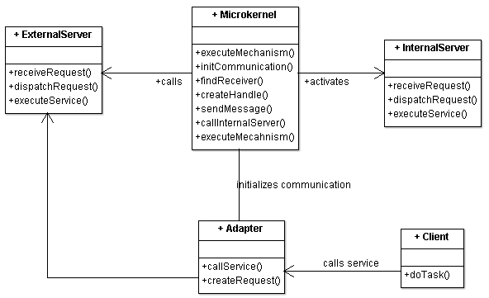
Microkernel
Main component of the pattern, which is optimized for memory
Provides core mechanisms
Encapsulates system specific dependencies : Hardware dependent parts
Maintain system resources such as Processes, Files
Provides a set of atomic services- known as mechanisms
More complex functionality can be built by composing these atomic services

Slide 21
Server
Internal Server
External Server (aka Personality)
Also known as subsystem
Extends functionality provided by Microkernel
Microkernel invokes services based on client requests
Example: Device drivers
Consider as extensions which are accessible to microkernel only
Implements it’s own ‘view’ of the underlying microkernel
E.g. OS/2 flavor on top of microkernel
MacOS on top of microkernel
Different servers implement different policies for specific application domains
Perform:
Receives service requests from client applications using the communication facilities provided by the microkernel
interprets these requests
executes the appropriate services
returns results to the clients

Slide 22
Client
Client
Adapter
Represents an application
Associated with exactly one external server
No direct communication, through Adapter only
Accesses the services provided by the external server
thru adapter as a service request
Protect the client from implementation details of the microkernel
Uses communication mechanism provided by the microkernel
Service requests from client
forwards the call to the appropriate server
Invokes methods of external servers on behalf of clients

Slide 23
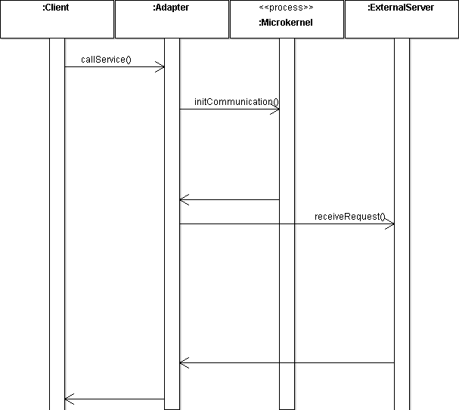
Client Request
createRequest()
findReceiver()
Determines the address of the external server
dispatchRequest()
Possibly an RPC
executeService()

Slide 24
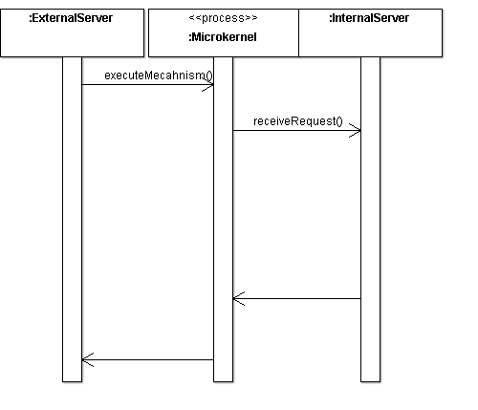
External Server Request
callInternalServer()
External server requests a service to microkernel
This service is provided by an internal server
Internal server can be a separate process or a shared library
executeService()

Slide 25
Implementation
# | Steps
1 | Analyze the application domain
2 | Analyze the external servers
3 | Categorize the servers
4 | Partition the categories
5 | Find a consistent and complete set of operations and abstractions
6 | Determine strategies for request transmission and retrieval
7 | Structure the microkernel component
8 | Specify the programming interfaces for the microkernel
9 | Microkernel is responsible for all the system resources
10 | Design and implement the internal servers
11 | Implement the external servers
12 | Implement the adapters
13 | Develop client applications

Slide 26
Client Requirement
2. Analyze External Servers
1. Analyze Application Domain
Identify the functionality required
Perform analysis to identify policies the external servers need to offer for the application domain
Analyze the policies the external servers are going to provide to define
High level interfaces required to be provided
List of services and service categories necessary

Slide 27
Category of Core Services
3. Categorize Services
4. Partition categories
Identify all core service functionality
Group them into a set of semantically-independent categories
Example: memory mgmt, process mgmt, low level I/O, communication
Identify categories which are not directly related to application domain
Page handler for processes, file system mgmt
Focus is to build the system infrastructure
Separate the categories of services that should belong to microkernel and internal servers
Typically based on frequency of use or hardware dependent will be part of microkernel
Page fault handlers, drivers and file system form part of internal servers

Slide 28
Core Service Design
5. Identify operations for each category
6. Determine communication strategies
Find a consistent and complete set of operations and abstractions
Microkernel provides mechanisms for the policies of external server; each policy is implemented thru use of services the microkernel offers
Example
Creating and terminating processes and threads
Specify the facilities that microkernel should provide for communication between components
Synchronous/Asynchronous
Relationship: one-to-one, many-to-one or a many-to-many
Build core services of message passing or shared memory, based on which the other services can be built

Slide 29
Microkernel
8:Specify the microkernel API
7:Structure the microkernel component
Separate system-specific parts from system-independent parts
Use Layer pattern
Lowermost – system specific
Uppermost – system independent; focusing on the services which microkernel will expose
Decide how the interfaces should be available externally
Microkernel as a
Separate process
Module physically shared by other components
Main Quality attribute: Efficiency and not make microkernel a bottle neck

Slide 30
Resource Management
9:Design Microkernel resource mgmt
10:Design & Implement Internal Servers
Implement strategies for sharing, locking, allocation and deallocation of resources
Maintain the information about resources and allow access to them in a coordinated and systematic way
Separate processes or shared libraries centered around resources
Active servers are implemented as processes
Passive servers are implemented as shared libraries
Graphics card driver → shared libraries
Page fault handler → separate processes

Slide 31
Client Access
12:Implement adapters
11:Implement external servers
Each external server is implemented as a separate process that provides it’s own service interface
Internal architecture depends on the policies it comprises
Specify how external servers dispatch requests to their internal procedures
Decide on strategy of adapter; one adapter for all clients or every client associated with one adapter (trade off)
Adapter needs to package all relevant information into a request and forwards the request to appropriate external server
Use “Proxy” pattern

Slide 32
Variants
Microkernel system with indirect Client-Server connections
Distributed Microkernel System

Slide 33
Relationship with Other Patterns
Broker
Coupling
Broker is decentralized
Microkernel is more tightly coupled
Client communiction
In broker, clients communicate via message passing
Microkernel uses adapter strategy so that clients do not call the service directly
Layer
Microkernel can be thought of as a variant of layered architecture
Each layer is a VM
Lowest layer – internal server
Middle layer external server+adapter
Topmost layer – client application

Slide 34
Pros and Cons
Benefits
Liability
Portability
Flexibility and Extensibility
Separation of policy and mechanism
Scalability
Reliability
Transparency
Performance
Complexity of design and implementation

Slide 35
Known Uses
Mach operating System
Amoeba operating System
Chorus
Windows NT
Symbian
Find (at least 2) more popular uses and document them
Conceptual Architecture of the Linux Kernel http://docs.huihoo.com/linux/kernel/a1/index.html

